Slide 1
Web API
Stream Search

Slide 2
What is Web API
API stands for Application Programming Interface,
It lets developers integrate any two parts of an application or any different applications together.
There are APIs for all types of systems, including operating systems, libraries, and the Web.
Web API is basically a set of dedicated URLs that return pure data responses

Slide 3
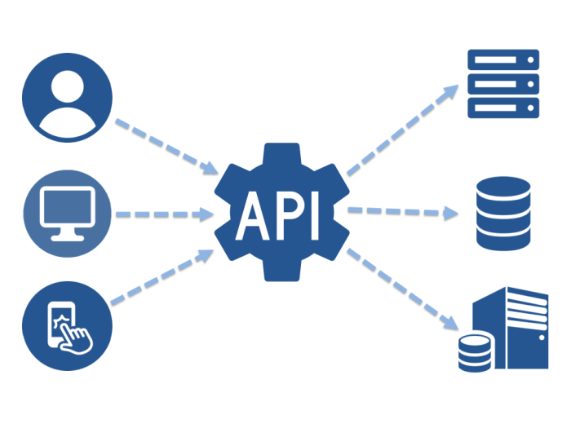

Slide 4

More info
Responses usually in JSON, sometimes XML.
Web APIs are currently based on REST architecture

Slide 5
REST
REST is acronym for REpresentational State Transfer. It contains rules for creation and use of Web API, which are:
1. Client–server 2. Stateless 3. Cacheable
4. Uniform interface 5. Layered system

Slide 6
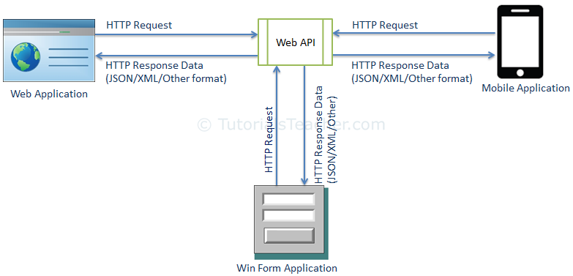

Slide 7

HTTP Methods
Here are the absolutely basic four methods of HTTP communication
GET – downloading data
PUT – actualize the data
POST –creating and sending data
DELETE – deleting of the data

Slide 8
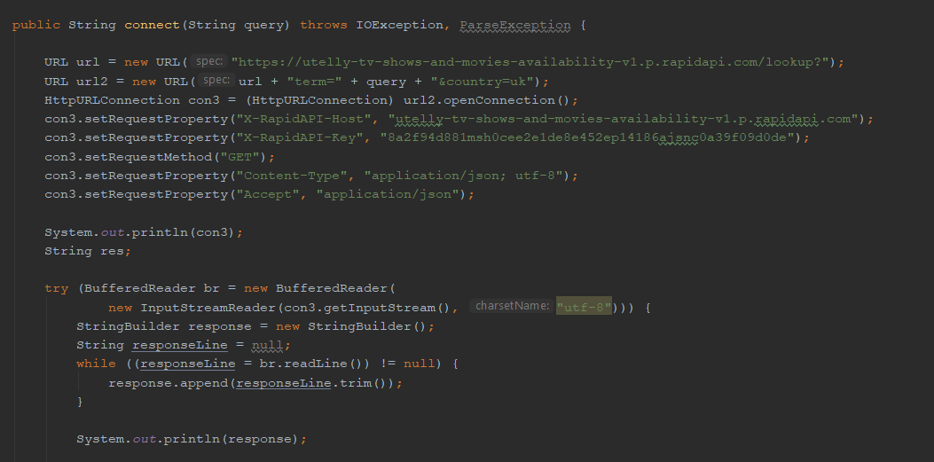
Get method example

Slide 9
Exercise 1
Use WEB API of NBP to obtain exchange rate of EURO by using GET method and links and classes provided
http://api.nbp.pl/

Slide 10
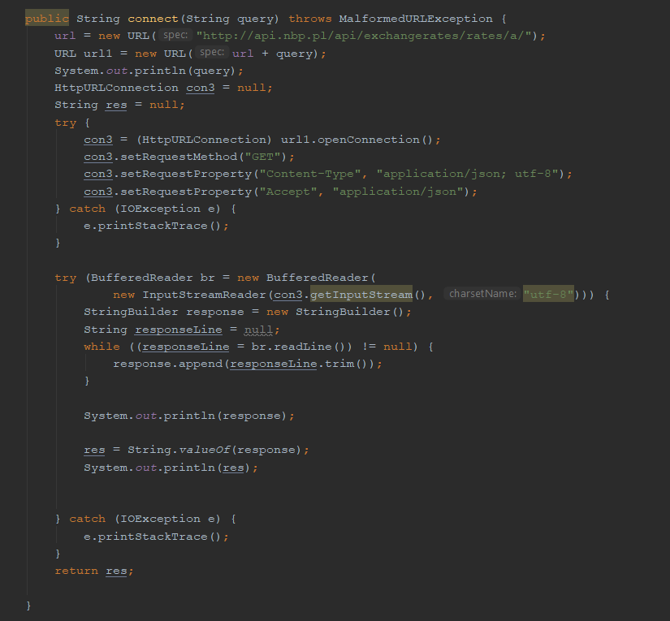
Solution

Slide 11
JSON
JSON (JavaScript Object Notation) is a lightweight data-interchange format. It is easy for humans to read and write. It is easy for machines to parse and generate.
JSON is built on two universal structures:
A collection of name/value pairs.
An ordered list of values. In most languages, this is realized as an array, vector, list, or sequence.

Slide 12
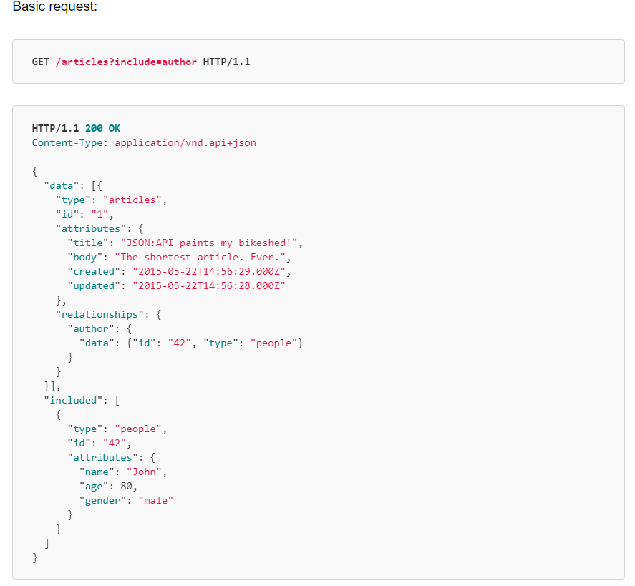
Example JSON
Responses

Slide 13
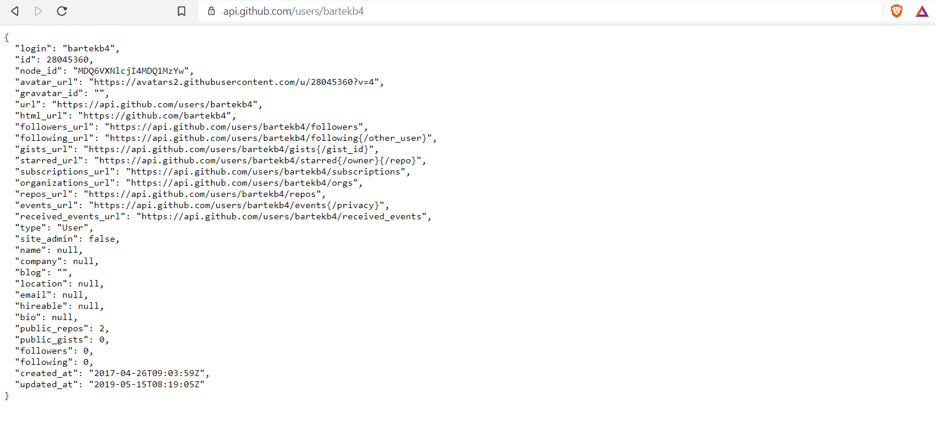
GITHUB API

Slide 14
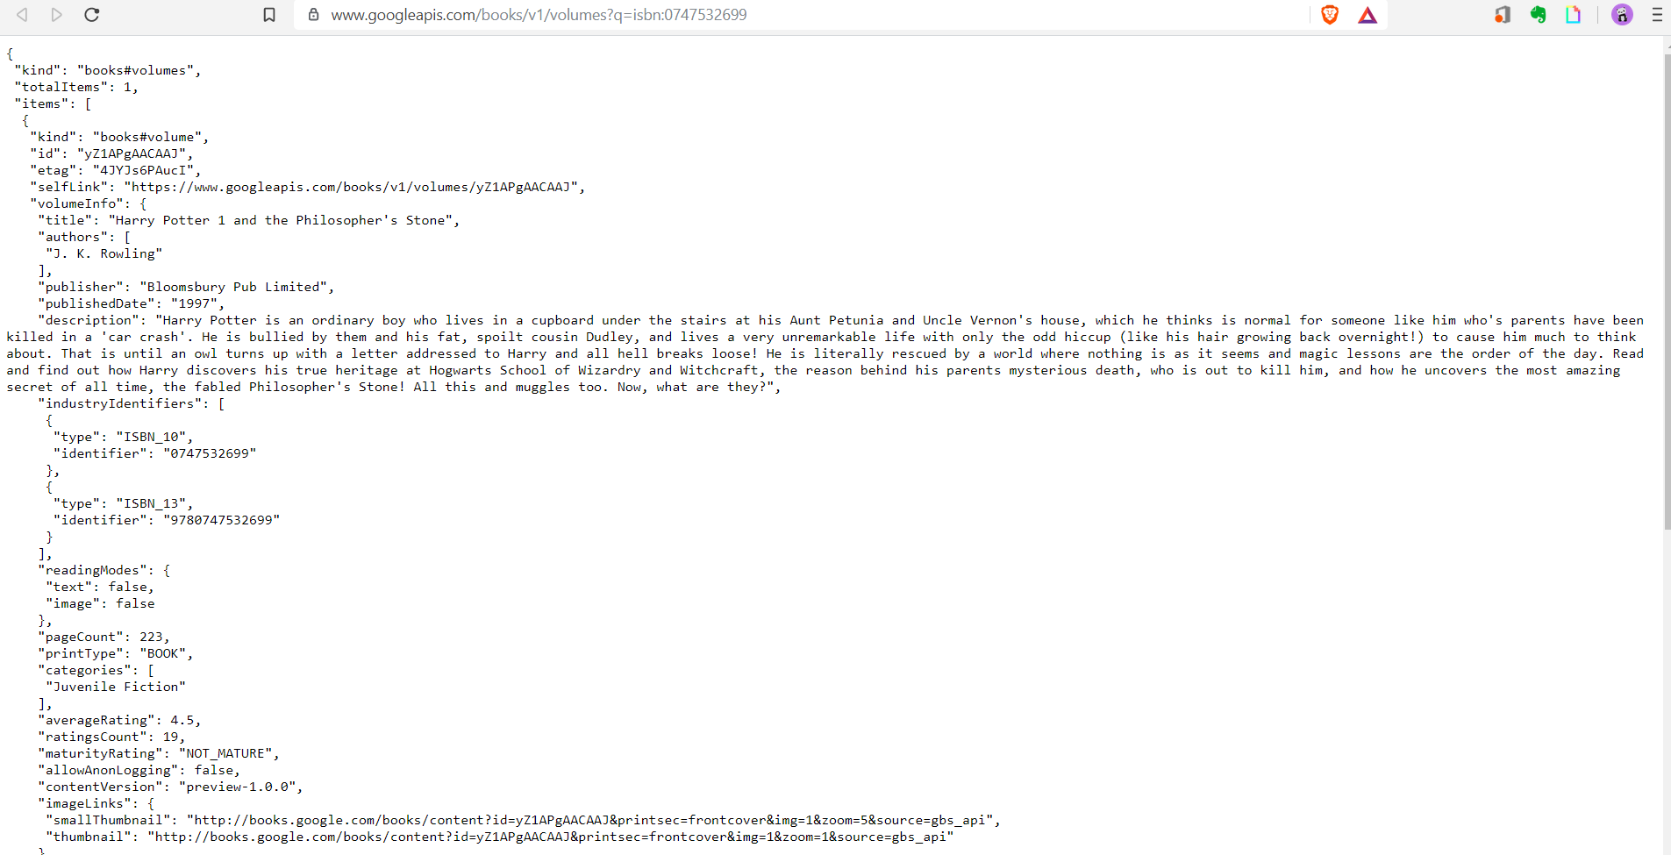
GOOGLE BOOKS API

Slide 15
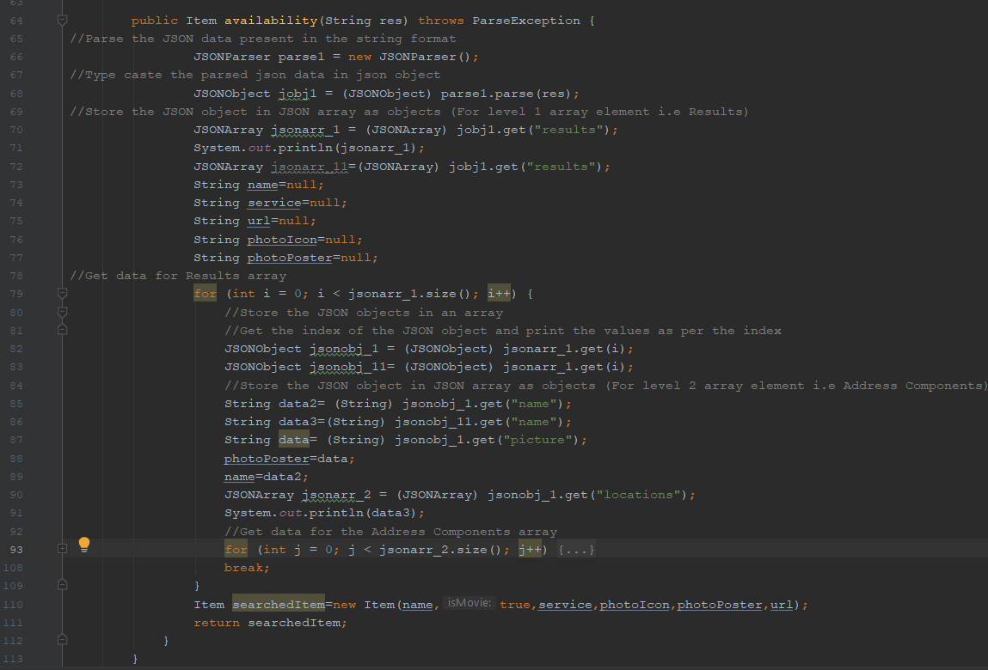
Parsing JSON responses

Slide 16
Exercise 2
Parse the JSON response to obtain only the value of exchange rate

Slide 17
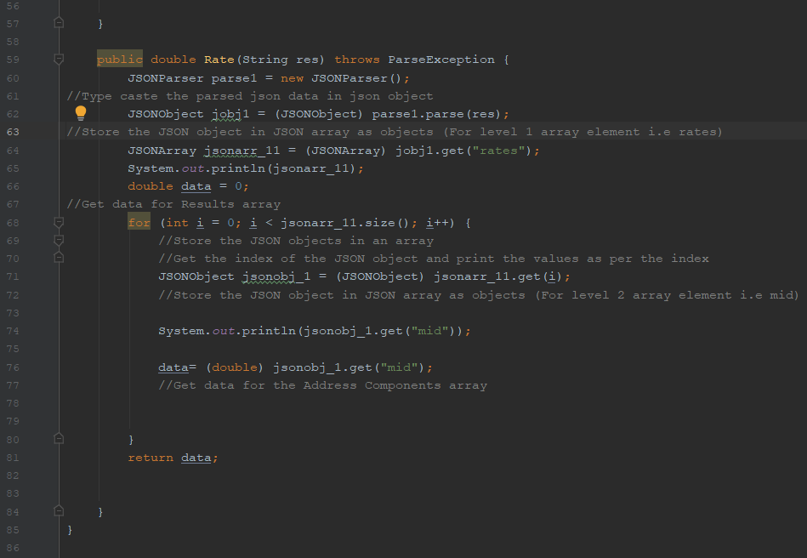
Solution

Slide 18
Excercise 3
Get data about air quality from api.gios.gov.pl
https://powietrze.gios.gov.pl/pjp/content/api

Slide 19
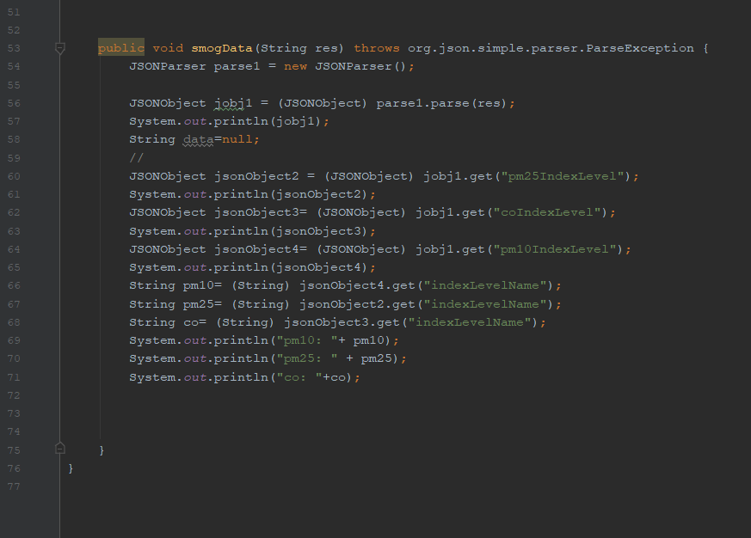
Solution

Slide 20
Project demo
StreamSearch is designed to help with searching for movies and series to watch in all streaming platforms. Using HTTP request program accesses Utelly Web API the database to search for desired parameters. Then they are used in User Interface, through which we can access the movie or series on the Internet.
As for this moment it works only for USA and UK databases.

Slide 21
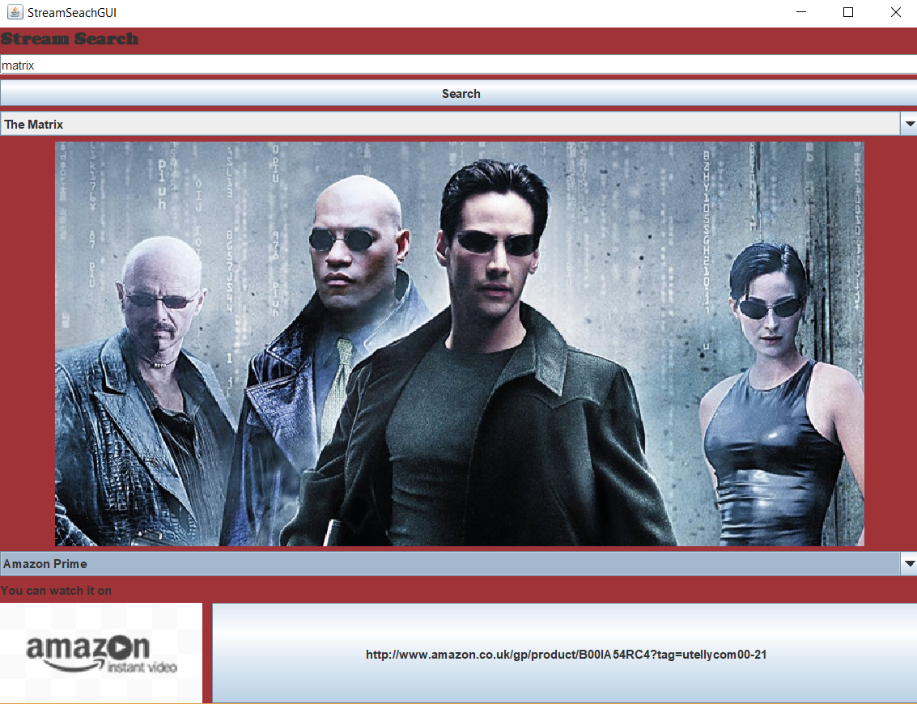

Slide 22
Exercise 4
Get verdicts from SAOS API concerning your keyword of choice.
https://www.saos.org.pl/help/index.php/dokumentacja-api

Slide 23
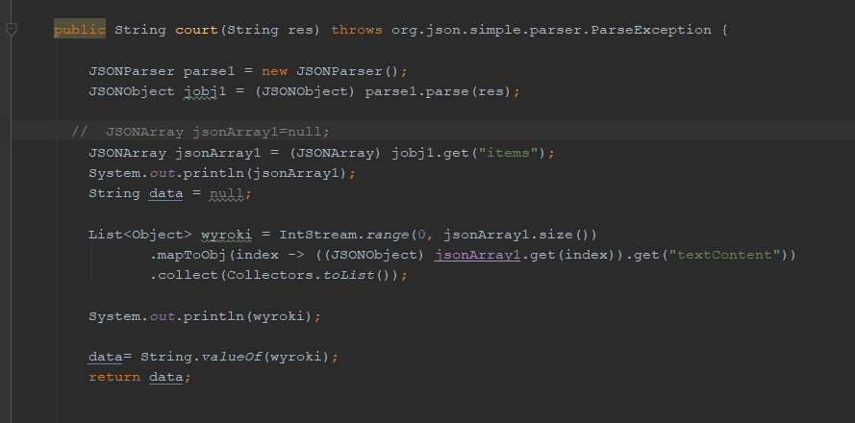
Solution

